Slide 1

SAMO
Seacom December Report

Slide 2
Summary of December Incident/tasks
SEACOM - % per Region
01
15
Type of incident logged
INCIDENT /TASK CALLS RAISED PER DAY
02
16
Detail of Summary of incident
03
Task per region
14

Slide 3

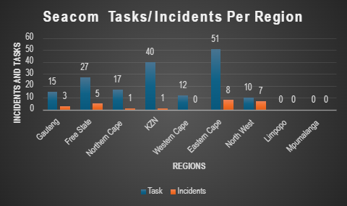
SEACOM/Fibreco Summary Report for November 2025
Seacom Tasks/Incident Per Region
Region | Task | Incidents | Total
Gauteng | 15 | 3 | 18
Free State | 27 | 5 | 32
Northern Cape | 17 | 1 | 18
KZN | 40 | 1 | 41
Western Cape | 12 | 0 | 12
Eastern Cape | 51 | 8 | 59
North West | 10 | 7 | 17
Limpopo | 0 | 0 | 0
Mpumalanga | 0 | 0 | 0
Total | 172 | 25 | 197
197 Total Tickets Logged
25 Incident Tickets logged
172 Task Tickets Logged
01

Slide 4
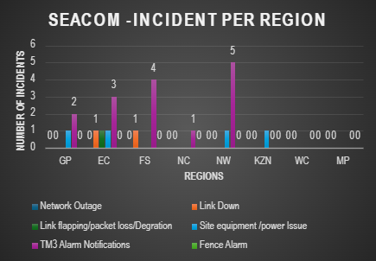
SEACOM - Fibreco Incident per Region
SEACOM -INCIDENT PER REGION
Seacom-Incident Tickets per Region | GP | EC | FS | NC | NW | KZN | WC | MP | TOTAL
Network Outage | 0 | 0 | 0 | 0 | 0 | 0 | 0 | 0 | 0
Link Down | 0 | 1 | 1 | 0 | 0 | 0 | 0 | 0 | 2
Link flapping/packet loss/Degration | 0 | 1 | 0 | 0 | 0 | 0 | 0 | 0 | 1
Site equipment /power Issue | 1 | 1 | 0 | 0 | 1 | 1 | 0 | 0 | 4
TM3 Alarm Notifications | 2 | 3 | 4 | 1 | 5 | 0 | 0 | 0 | 15
Fuel replenishment | 0 | 2 | 0 | 0 | 1 | 0 | 0 | 0 | 3
Fence Alarm | 0 | 0 | 0 | 0 | 0 | 0 | 0 | 0 | 0
Totals | 3 | 8 | 5 | 1 | 7 | 1 | 0 | 0 | 25
02

Slide 5
Detail Breakdown of Calls, Tasks, Incidents
Seacom Ref | Requester | Created date and time | Subject | Request Type | Classification | Region
391131 | Nkosinathi Nsibanyoni | 01/12/2025 02:45am | Access for Potch weekly maintenance | Task | Weekly Site/Route Routine | North West
391078 | SNOC HPIM | 01/12/2025 04:58am | Need to troubleshoot dark fiber links at MTN Queenstown | Task | RHS - Fault Testing | Eastern Cape
391079 | SNOC HPIM | 01/12/2025 04:58am | Need to troubleshoot dark fiber links at Vodacom Queenstown | Task | RHS - Fault Testing | Eastern Cape
391092 | Anderson Kawire | 01/12/12025 05:08am | Move patch at Teraco Isando | Task | RHS - Equipment/patch/SFP Installation | Gauteng
391258 | SNOC | 01/12/12025 10:35am | Urgent Arrange RHS with Site access at MTN Esparanza | Incident | Link Down | Eastern Cape
NET-105489 | SNOC | 01/12/12025 14:19pm | Re: Observing on gen common + low fual alarm at Fiberco Heidelberg. 1st Dec 2025 | Incident | TM3 Alarm Notifications | Gauteng
391407 | SNOC | 01/12/12025 15:55pm | RHS request at Teraco Isando_03 December | Task | RHS - Equipment/patch/SFP Installation | Gauteng
391460 | kopano.Rahlano | 01/12/12025 17:11pm | Access for Estcourt Observation 02 December 2025 | Task | Weekly Site/Route Routine | KZN
391461 | kopano.Rahlano | 01/12/12025 17:12pm | Access for Harrismith Observation 02 December 2025 | Task | Weekly Site/Route Routine | KZN
391463 | kopano.Rahlano | 01/12/12025 17:12pm | Access for Estcourt repeater 02 December 2025 | Task | Weekly Site/Route Routine | KZN
391462 | kopano.Rahlano | 01/12/12025 17:12pm | Access for Harrismith repeater 02 December 2025 | Task | Weekly Site/Route Routine | KZN
391464 | kopano.Rahlano | 01/12/12025 17:13pm | Access for Estcourt diesel 02 December 2025 | Task | Weekly Site/Route Routine | KZN
391465 | kopano.Rahlano | 01/12/12025 17:13pm | Access for Harrismith diesel 02 December 2025 | Task | Weekly Site/Route Routine | KZN
391417 | Anderson Kawire | 01/12/2025 21:09pm | RHS IP Engineering-Juniper MX10K Installationv1 Teraco Isando 8th Dec | Task | RHS - Equipment/patch/SFP Installation | Gauteng
391570 | Zola Momoza | 01/12/2025 23:26pm | Access for EL IS DC weekly routine | Task | Weekly Site/Route Routine | Eastern Cape
391571 | Zola Momoza | 01/12/2025 23:26pm | Access for EL Metro weekly routine | Task | Weekly Site/Route Routine | Eastern Cape
391713 | SNOC | 02/12/2025 11:37pm | Urgent Arrange RHS at Queenstown | Task | RHS - Fault Testing | Eastern Cape
391694 | SNOC | 02/12/2025 13:04pm | RHS Request for FibreCo Potchefstroom and Klerksdorp 03 Dec | Task | RHS - Access | North West
391832 | Thomas | 02/12/2025 15:04pm | Access for MTN_NLD Repeater site visits 1st Round December 2025 | Task | Weekly Site/Route Routine | Western Cape
391888 | Frikkie | 02/12/2025 18:27pm | Asset Verification Cape Town 05 Dec | Task | RHS - Site Survey/visit/meetings | Western Cape
391962 | Dumisani Mdlalose | 02/12/2025 22:52pm | Weekly routine Kimberley | Task | Weekly Site/Route Routine | Northern Cape
391969 | Dumisani Mdlalose | 02/12/2025 22:52pm | Weekly routine De Toitspan | Task | Weekly Site/Route Routine | Northern Cape
391978 | Delvin Basira | 02/12/2025 23:44pm | Bloem IS weekly maintenance | Task | Weekly Site/Route Routine | Free State
391981 | Mkhuseli Ndibongo | 03/12/2025 00:40am | Weekly route drive KAA | Task | Weekly Site/Route Routine | Eastern Cape
392018 | HPIM | 03/12/2025 07:06am | Urgent Arrange RHS with site access at Wolmaransstad | Task | RHS - Fault Testing | Northern Cape
392033 | Zola Momoza | 03/12/2025 07:45am | Access for 03 December 2025 | Task | Weekly Site/Route Routine | Eastern Cape
392066 | Esther | 03/12/2025 09:54am | Urgent RHS and site access on 07:30 GMT/03rd Dec 2025 onwards at Teraco Riverhorse | Task | RHS - Fault Testing | KZN
NET-105794 | SNOC | 03/12/2025 13:29pm | Re: RHS_at_SEACOM Potchefstroom Repeater TM3 node-NET-105794 | Incident | TM3 Alarm Notifications | North West
392208 | Kaustubh Ovarikar | 03/12/2025 14:29pm | RHS Request at Teraco Riverhorse on 4th-Dec-2025 for liquid delivery | Task | RHS - Equipment/patch/SFP Installation | KZN
392210 | HPIM | 03/12/2025 14:55pm | RHS and Site access Stutterheim for Vodacom Link issue 3rd Dec 2025 | Task | RHS - Access | Eastern Cape
392190 | Shaun Mpfuni | 03/12/2025 15:12pm | Request for Site Access and Assistance – Monday, 8 December | Task | RHS - Fault Testing | Western Cape
392197 | Shaun Mpfuni | 03/12/2025 15:26pm | RHS support at Teraco Isando on 4th December 2025 | Task | RHS - Equipment | Gauteng
392224 | HPIM | 03/12/2025 16:12pm | Urgent RHS & Site access request on Teraco Access Request - 03rd Dec 2025 13:30 GMT | Task | RHS - Fault Testing | Western Cape
391658 | Ryan Slyvester | 03/12/2025 21:12pm | Site Access at SMI 04 Dec | Task | RHS - Access | Free State
392380 | Ishmael | 03/12/2025 23:38pm | Weekly maintenance GLE 04 Dec | Task | Weekly Site/Route Routine | Eastern Cape
392381 | Delvin Basira | 03/12/2025 23:40pm | Access for KLE weekly maintenance 04 Dec | Task | Weekly Site/Route Routine | Free State
392382 | Delvin Basira | 03/12/2025 23:40pm | Access for VEN weekly maintenance 04 Dec | Task | Weekly Site/Route Routine | Free State
03

Slide 6
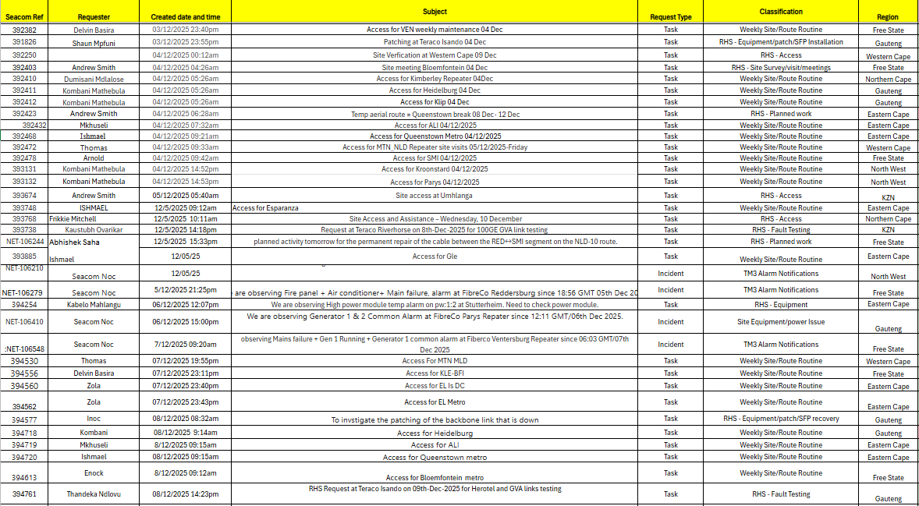
04

Slide 7
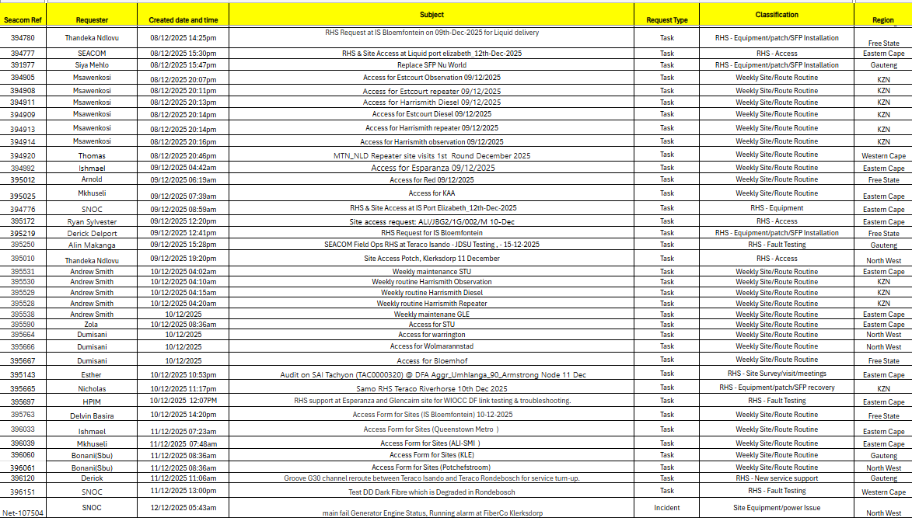
05

Slide 8
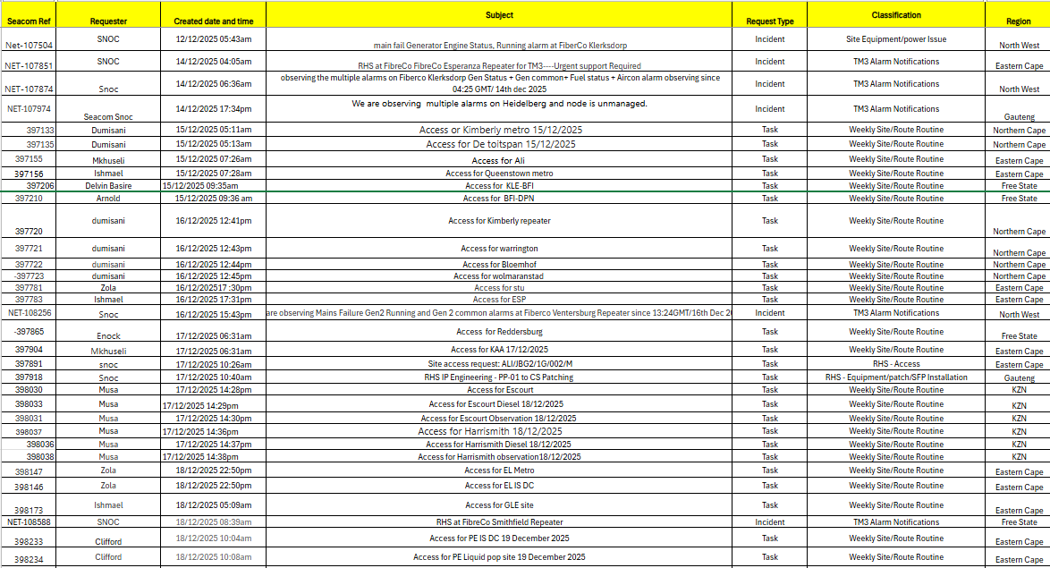
06

Slide 9
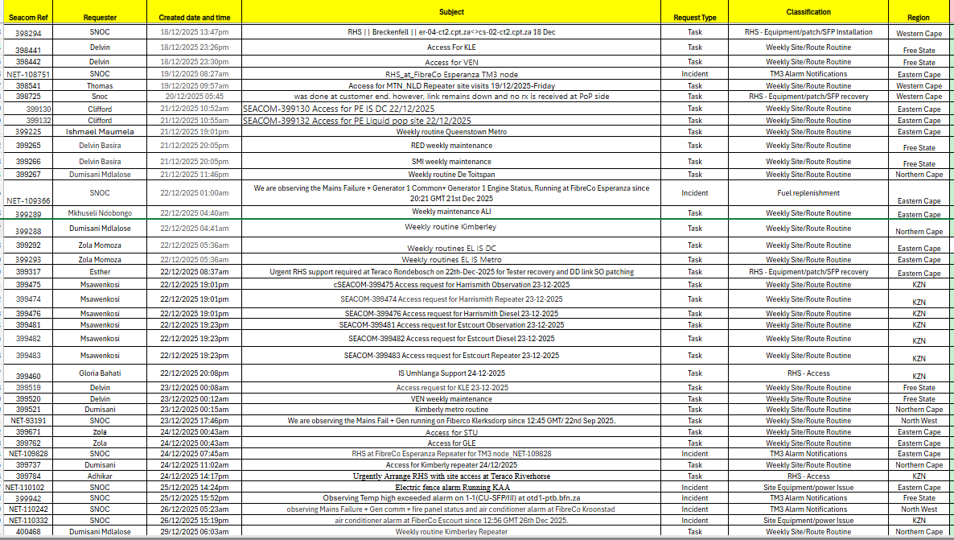
07

Slide 10
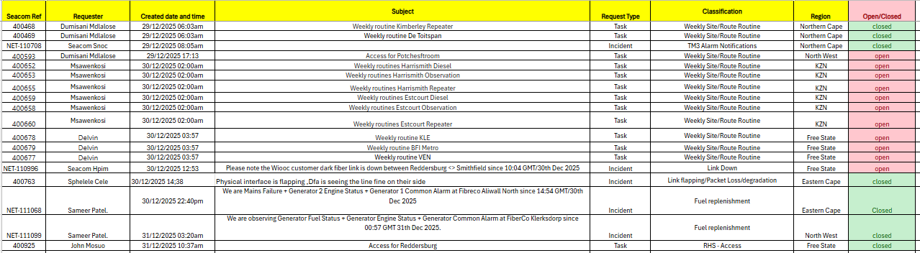
08

Slide 11
SEACOM - Fibreco Task per Region
SEACOM -TASK REQUEST TICKETS PER REGION
 | GP | EC | FS | NC | NW | KZN | WC | MP | Totals
RHS ACCESS | 0 | 4 | 2 | 1 | 2 | 3 | 1 | 0 | 13
RHS -FAULT TESTING | 2 | 4 | 0 | 1 | 0 | 2 | 3 | 0 | 12
RHS-EQUIPMENT/PATCH/SFP INSTALLATION | 6 | 0 | 2 | 0 | 0 | 1 | 1 | 0 | 10
RHS-EQUIPMENT/PATCH/SFP RECOVERY | 1 | 1 | 0 | 0 | 0 | 1 | 1 | 0 | 4
RHS-Planned Work | 0 | 1 | 1 | 0 | 0 | 0 | 0 | 0 | 2
RHS-SITESURVEY/VISIT/MEETING | 0 | 1 | 1 | 0 | 0 | 0 | 1 | 0 | 3
RHS- 3RD PARTY NETWORK SUPPORT | 0 | 0 | 0 | 0 | 0 | 0 | 0 | 0 | 0
RHS-NEW SERVICE SUPPORT | 1 | 0 | 0 | 0 | 0 | 0 | 0 | 0 | 1
RHS-SUPERVISION | 0 | 0 | 0 | 0 | 0 | 0 | 0 | 0 | 0
CPE INSTALLATION | 0 | 0 | 0 | 0 | 0 | 0 | 0 | 0 | 0
SITE /PLANT/EQUIPMENT ISSUES | 0 | 0 | 0 | 0 | 0 | 0 | 0 | 0 | 0
WEEKLY SITE/ROUTE ROUTINE | 5 | 40 | 21 | 15 | 8 | 33 | 5 | 0 | 127
WAREHOUSING /STOCK | 0 | 0 | 0 | 0 | 0 | 0 | 0 | 0 | 0
CALL TICKET INFORMATION UNCLEAR | 0 | 0 | 0 | 0 | 0 | 0 | 0 | 0 | 0
TOTALS | 15 | 51 | 27 | 17 | 10 | 40 | 12 | 0 | 172
14

Slide 12
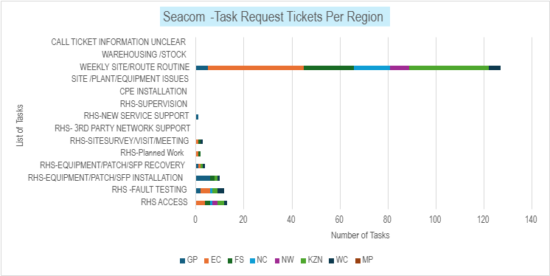
SEACOM - Fibreco Task per Region
14

Slide 13
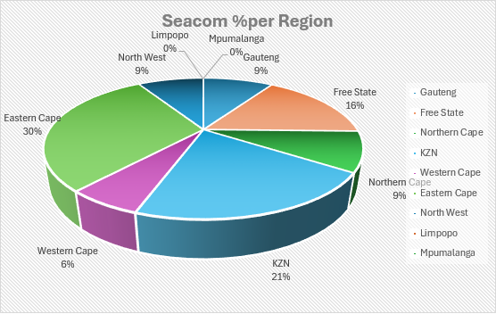
SEACOM - % per Region
Seacom % Per Region
Region | Total
Gauteng | 18
Free State | 32
Northern Cape | 18
KZN | 41
Western Cape | 12
Eastern Cape | 59
North West | 17
Limpopo | 0
Mpumalanga | 0
Total | 197
15

Slide 14
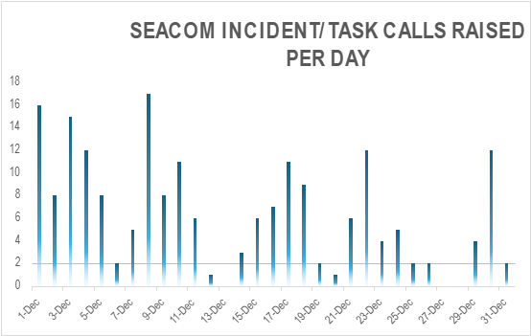
Calls Per Day
16

Slide 15


